Slide 1
Classification
Huijun Di
ajon@bit.edu.cn

Slide 2
Outline
Introduction
kNN
SVM
Cross validation
Summary

Slide 3
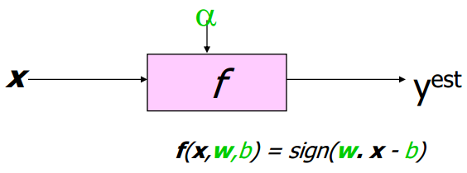
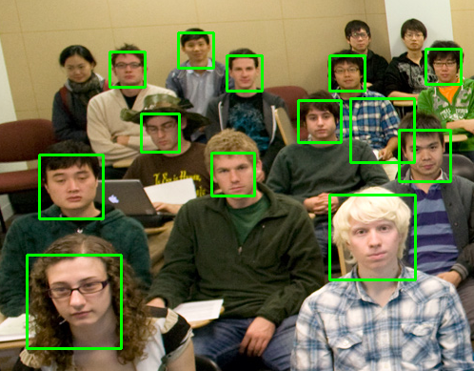
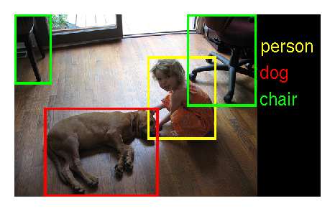
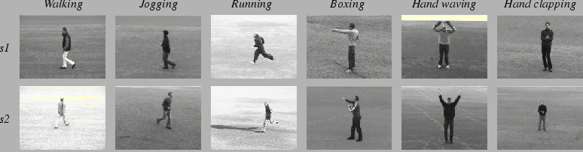
Introduction
Classification (supervised)
Training: given (x_{i},y_{i}=label), learn f: y=f(x)
Testing: for new data x', calc f(x')
Example
Face Recognition: Face/non face
Image Classification
Action Recognition

Slide 4
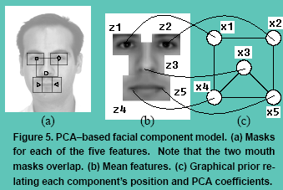


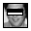

Possible approaches to classification
Generative approach
separately model class-conditional densities and priors, then evaluate posterior probabilities using Bayesian theorem
explain the input
if we randomly sample from the probability model, we can generate a sample of possible observed data
Discriminative approaches
model posterior probabilities directly : f(x)=p(y|x)
make a decision
just predict class label (no inference stage)

Slide 5
Discriminative approaches
Two issues
How to define f
How to learn it
Many ways
kNN: define f by data samples
f: linear/non-linear scalar/vector function, with hidden variables
learning: LDA (dim reduction), SVM (max margin learning), regression, neural network, boosting, decision trees...
SVM: Linear SVM, Kernel SVM, Structural SVM (vector function), Latent SVM (with hidden variables)

Slide 6
Outline
Introduction
kNN
SVM
Cross validation
Summary

Slide 7
kNN(k Nearest Neighbors) classification
Non-parametric density estimation
kNN density estimation
kNN classification
Optimizing storage requirements
Optimizing computational efficiency
KD-Tree, Locally Sensitive Hashing

Slide 8
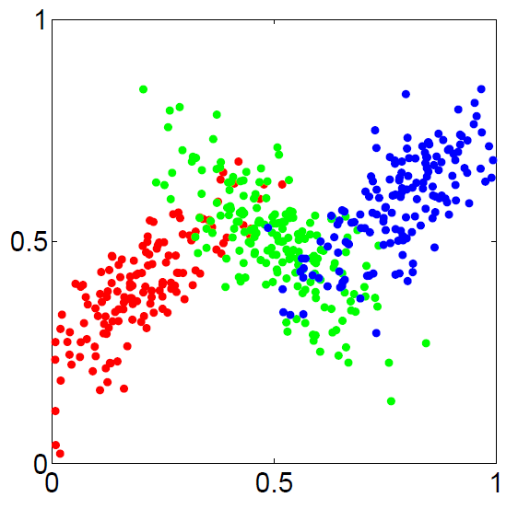
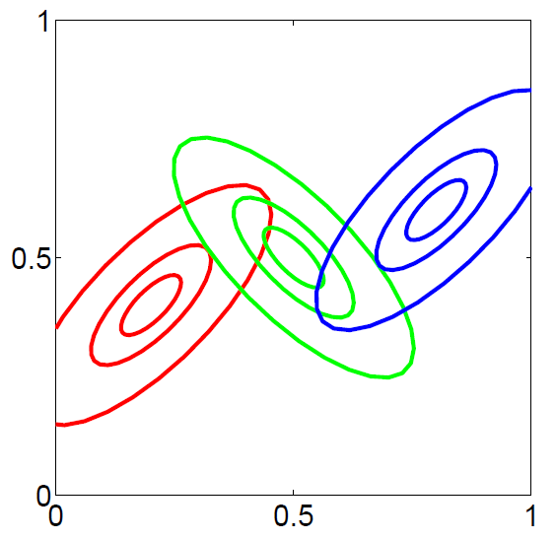
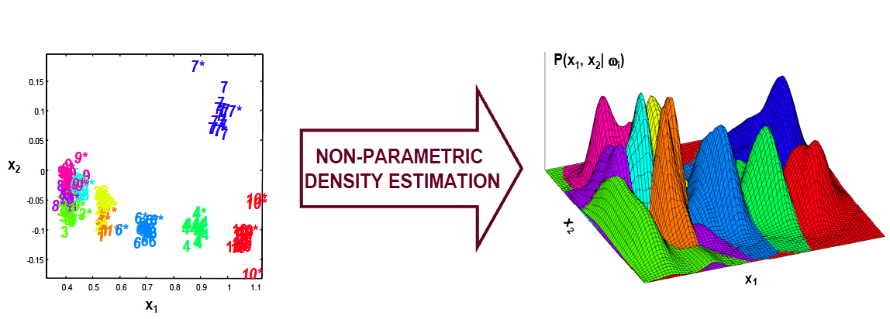
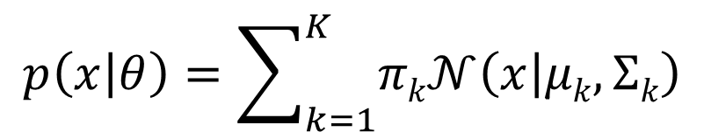
Density estimation
parametric density estimation
Gaussian Mixture Model (GMM)
non-parametric density estimation
$$p\left(x | θ\right)=\sum_{k=1}^{K}{πk𝒩\left(x | μk,Σk\right)}$$

Slide 9
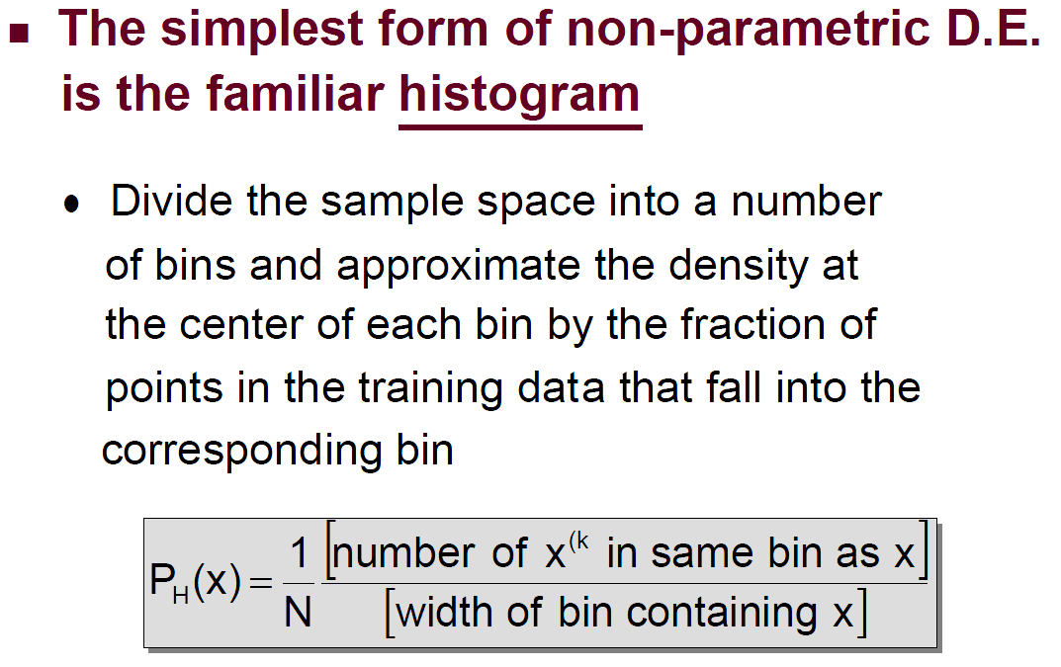
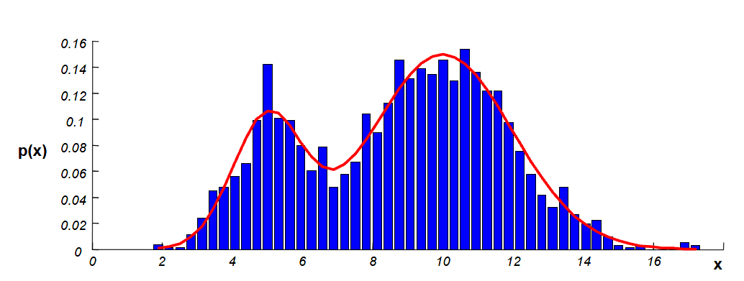
non-parametric density estimation

Slide 10
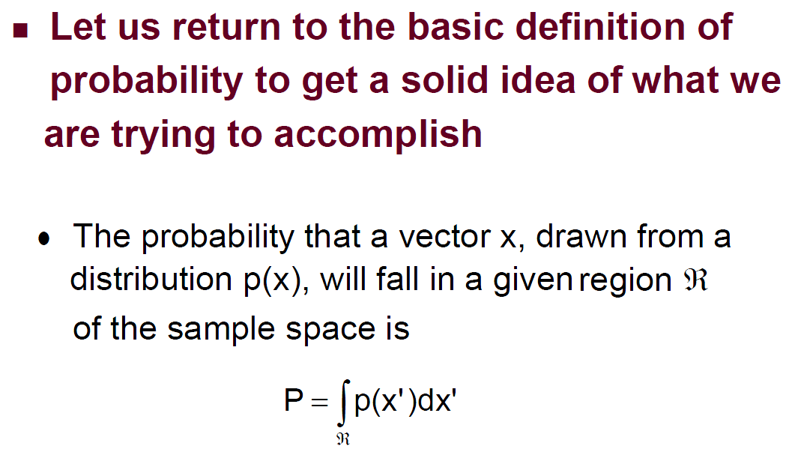
non-parametric density estimation

Slide 11
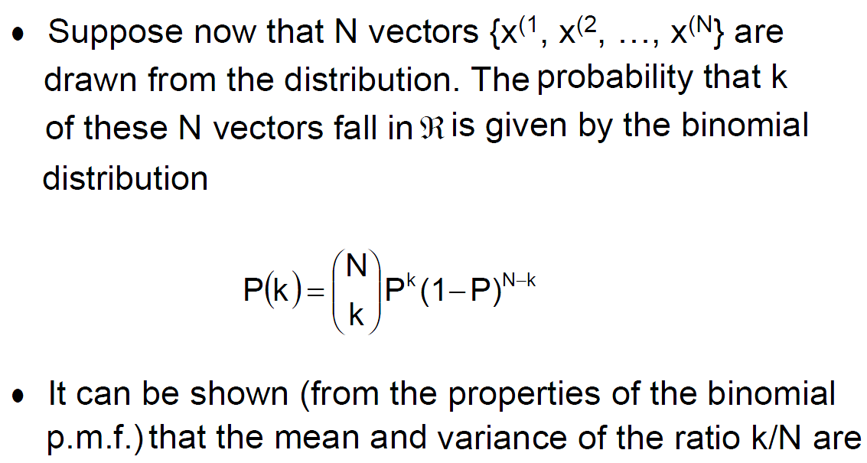
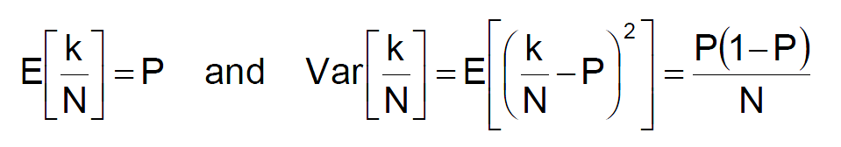
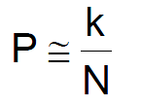
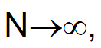
non-parametric density estimation

Slide 12
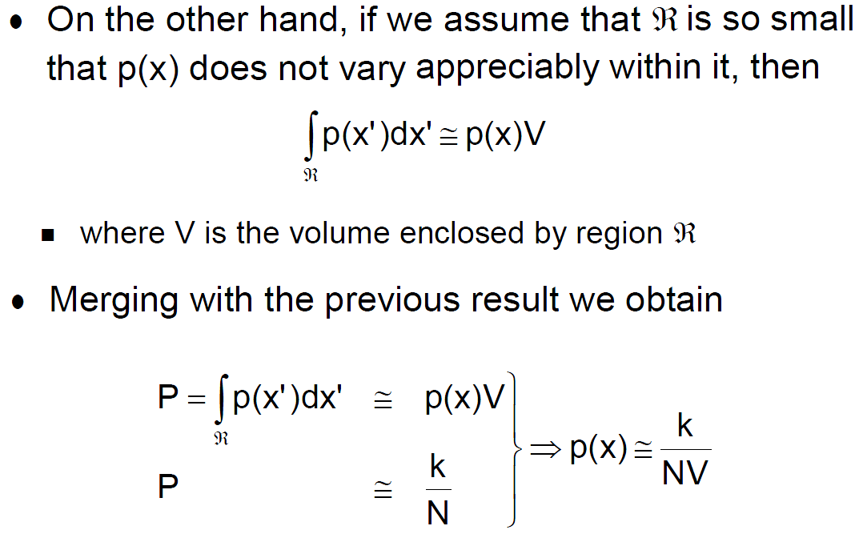
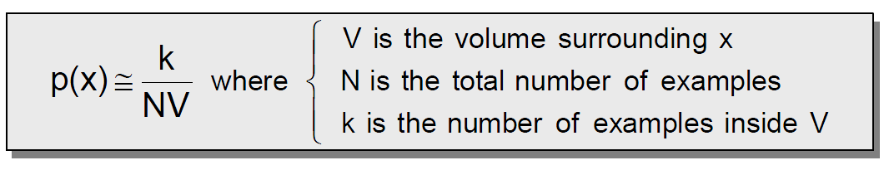
non-parametric density estimation

Slide 13
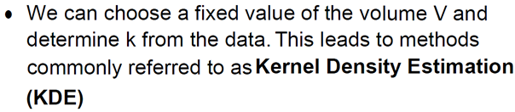
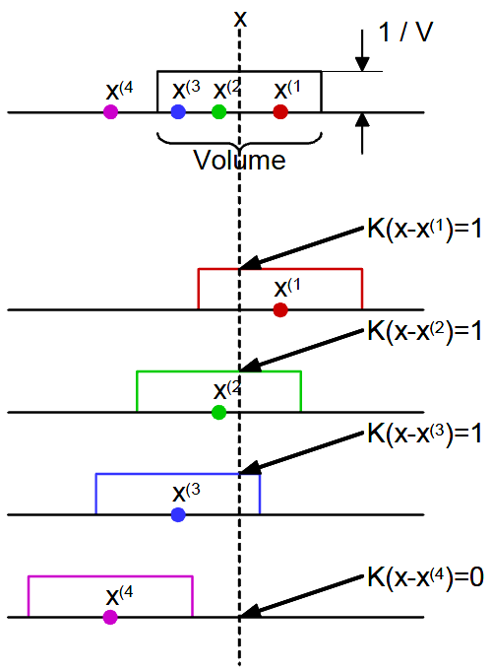
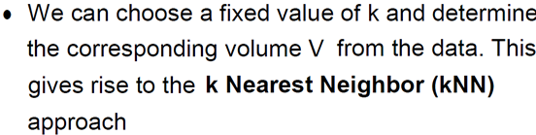
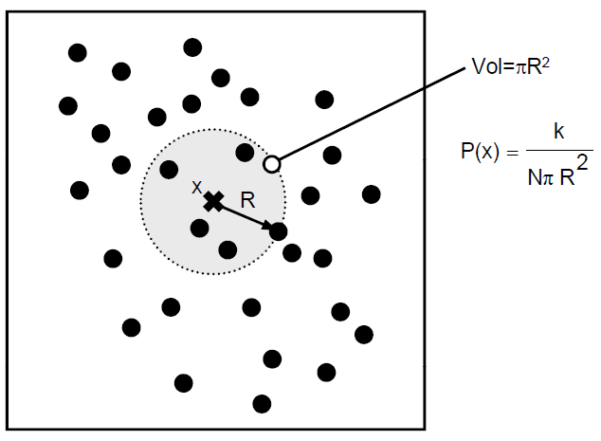
non-parametric density estimation

Slide 14
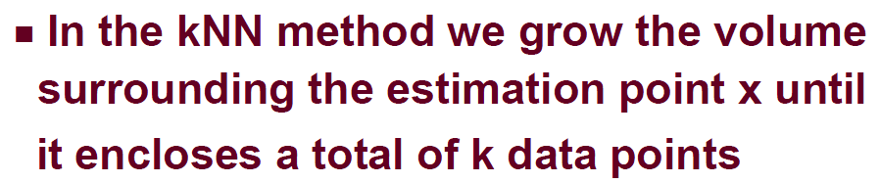
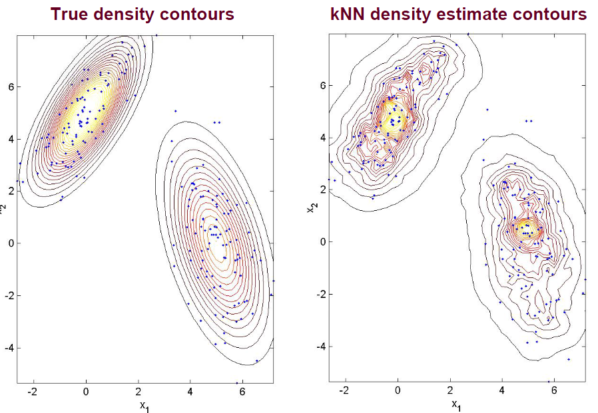
kNN density estimation

Slide 15
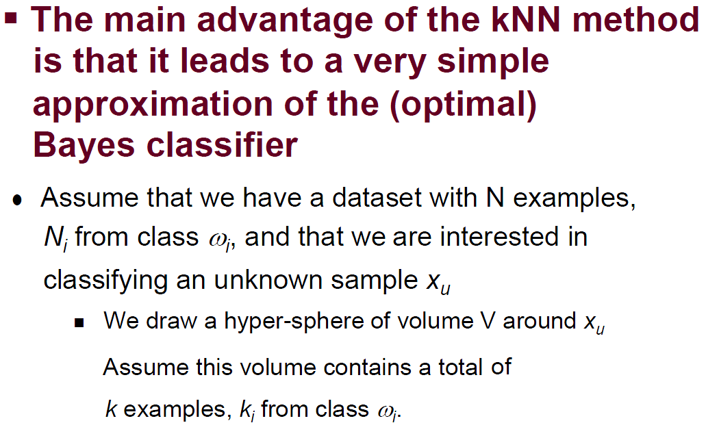
kNN classification

Slide 16
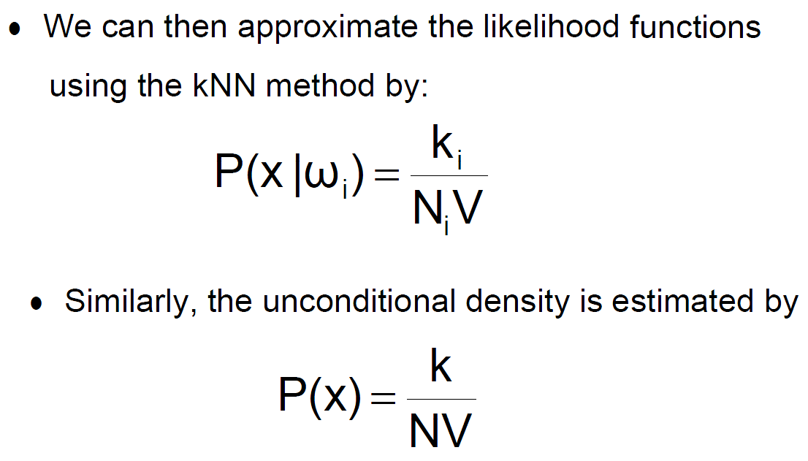
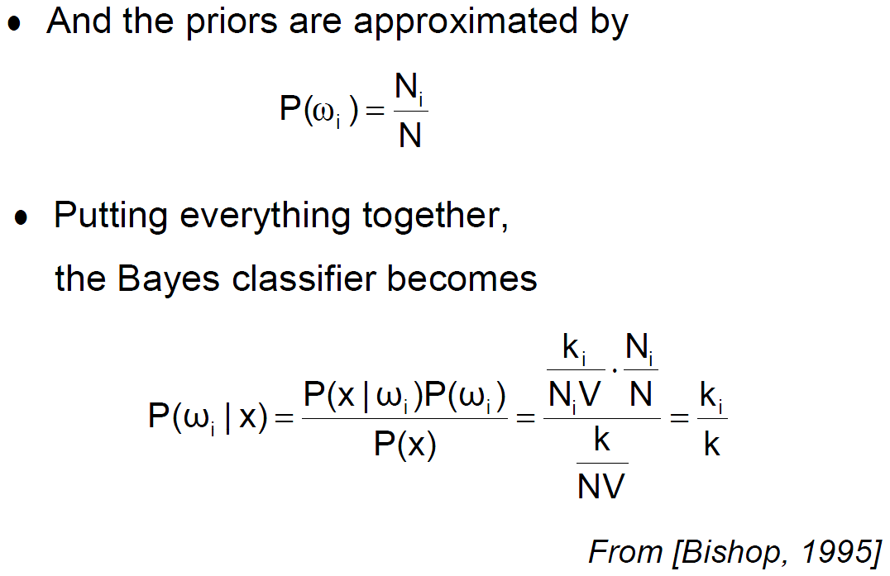
kNN classification

Slide 17
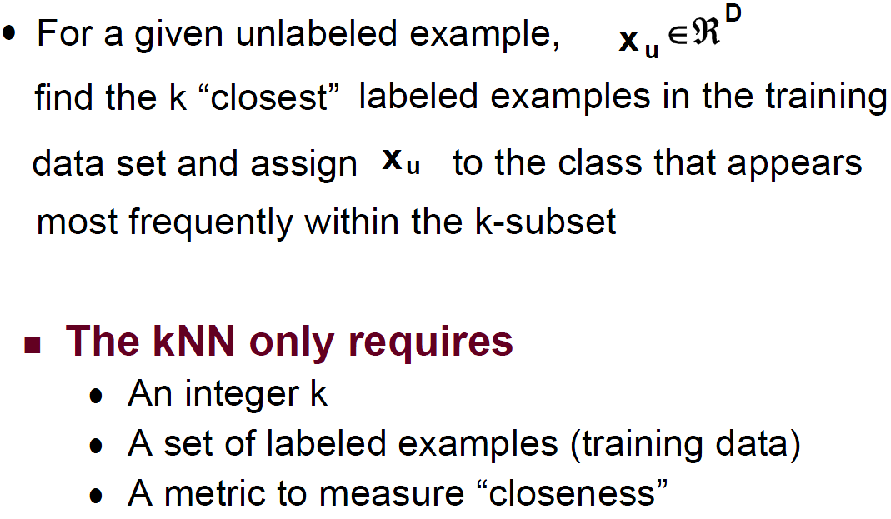
kNN classification

Slide 18
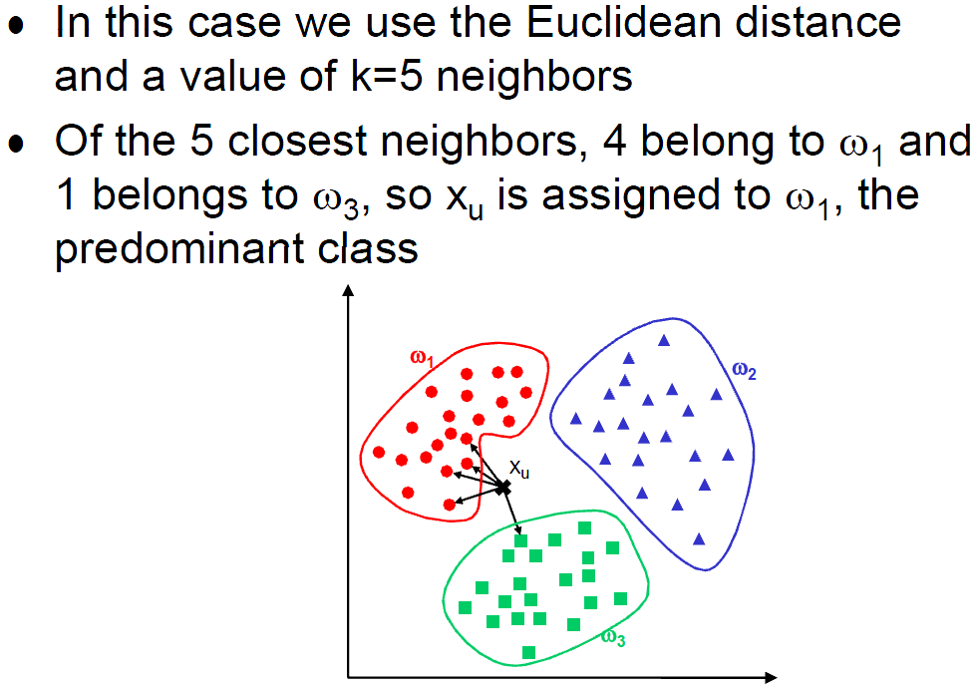
kNN classification

Slide 19
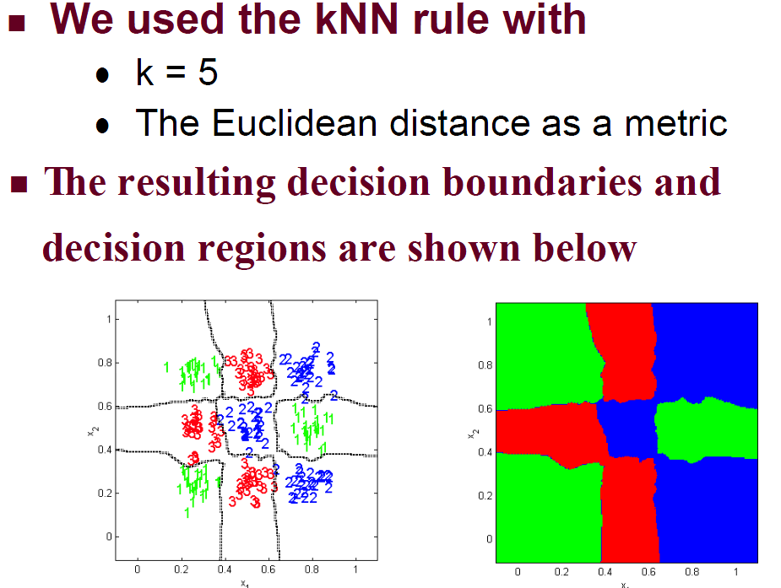
kNN classification

Slide 20
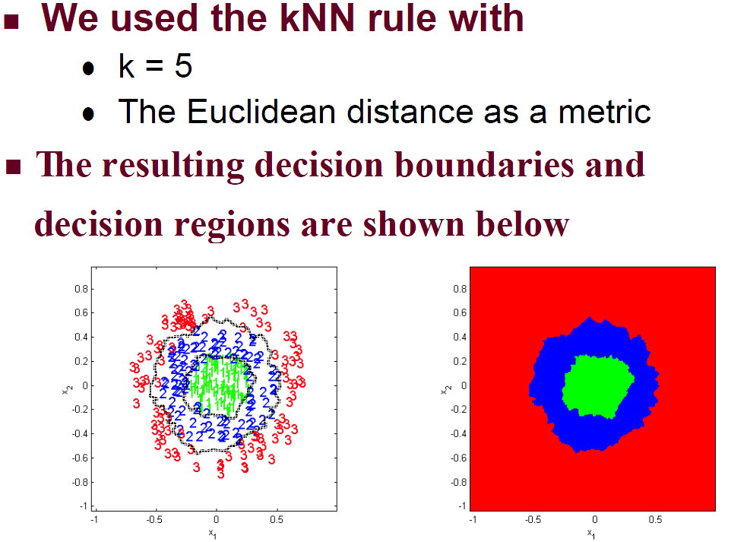
kNN classification

Slide 21
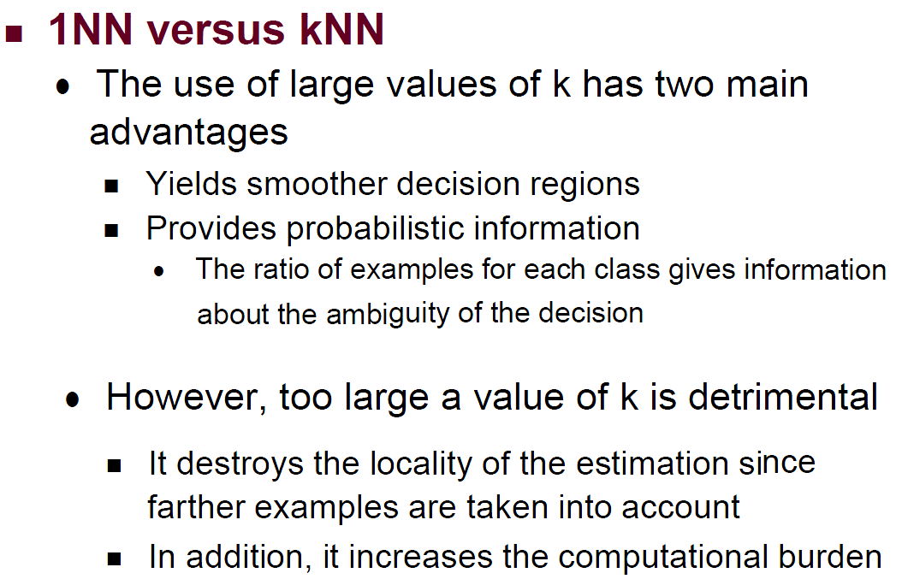
kNN classification

Slide 22
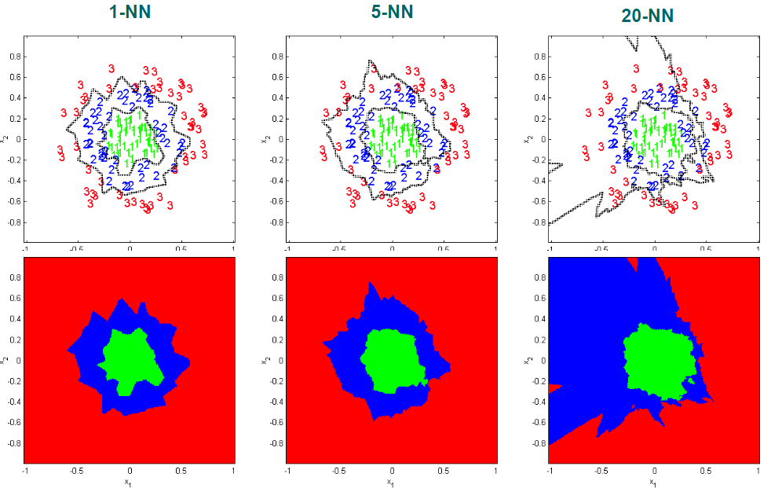
kNN classification

Slide 23
kNN(k Nearest Neighbors) classification
non-parametric density estimation
kNN density estimation
kNN classification
Optimizing storage requirements
Optimizing computational efficiency
KD-Tree, Locally Sensitive Hashing

Slide 24
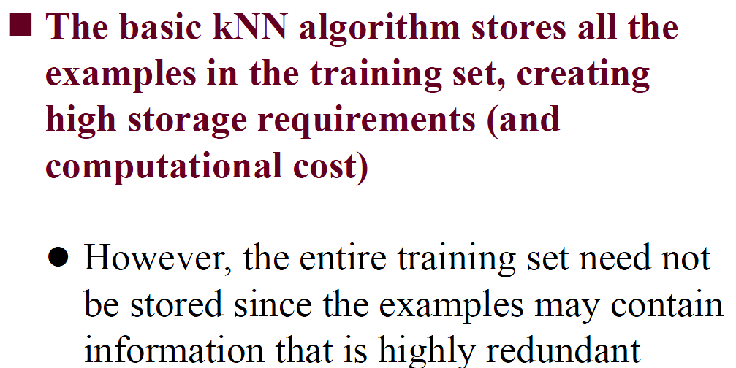
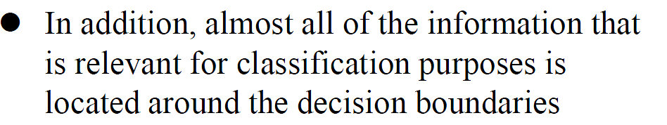
Optimizing storage requirements

Slide 25
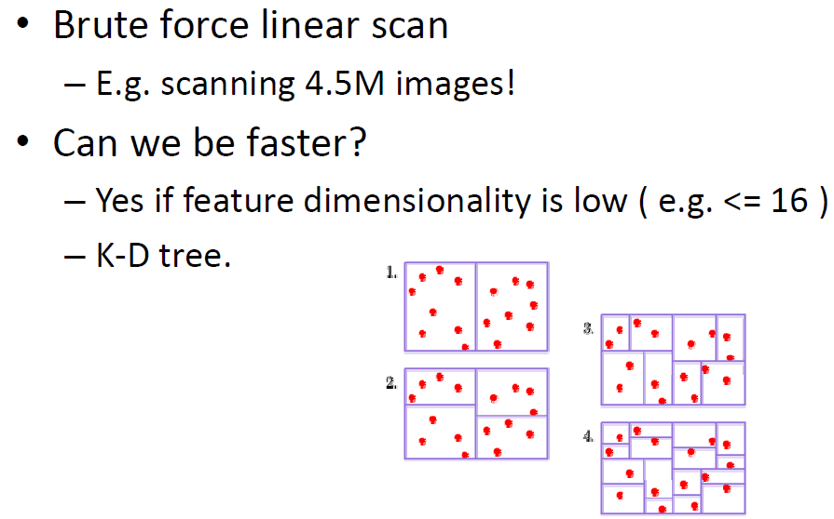
How fast is kNN?

Slide 26
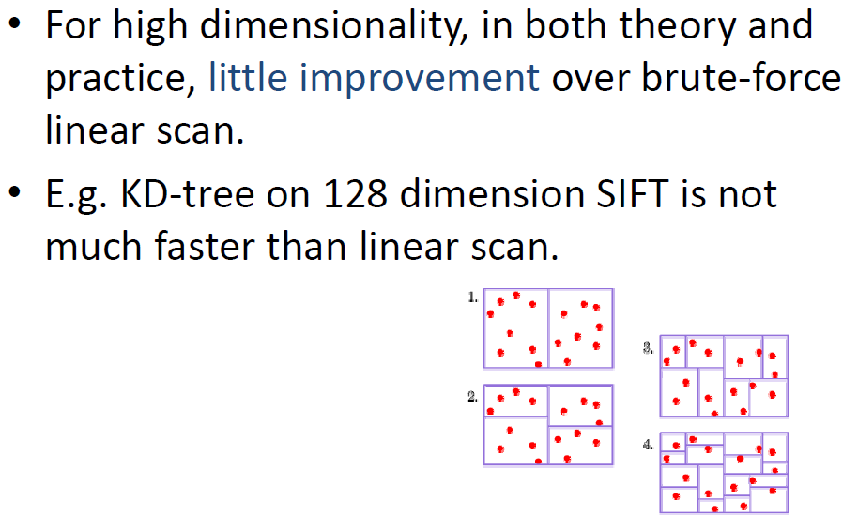
Curse of dimensionality

Slide 27
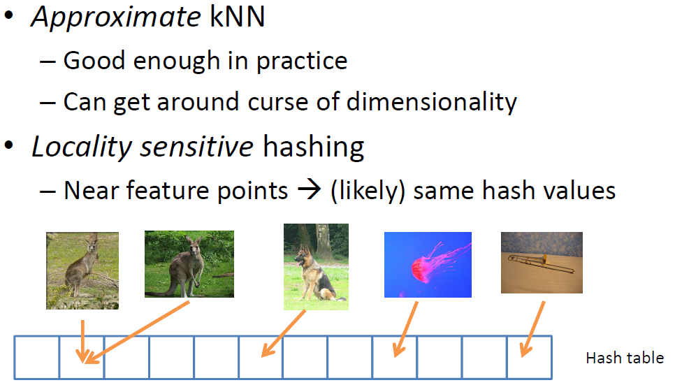
Locally Sensitive Hashing

Slide 28
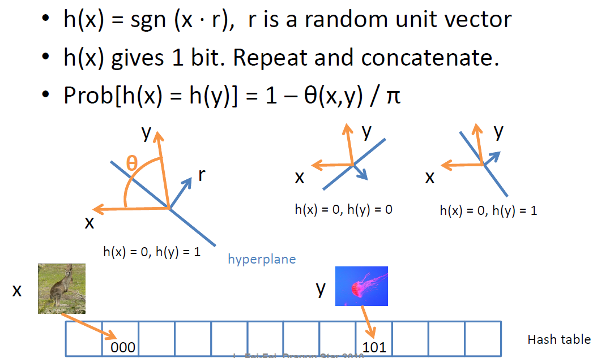
Example: Random projection

Slide 29
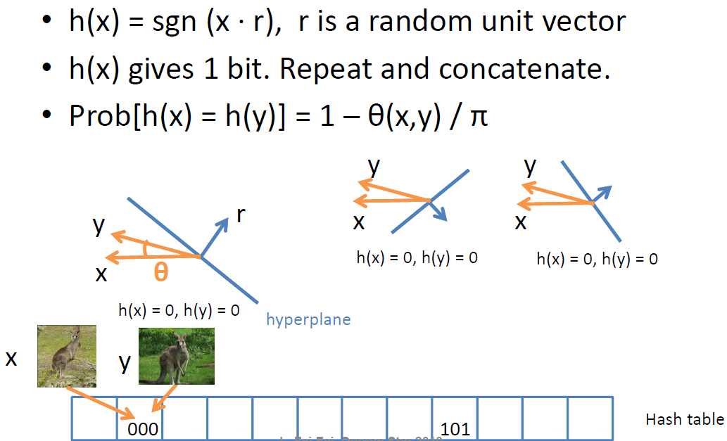
Example: Random projection

Slide 30
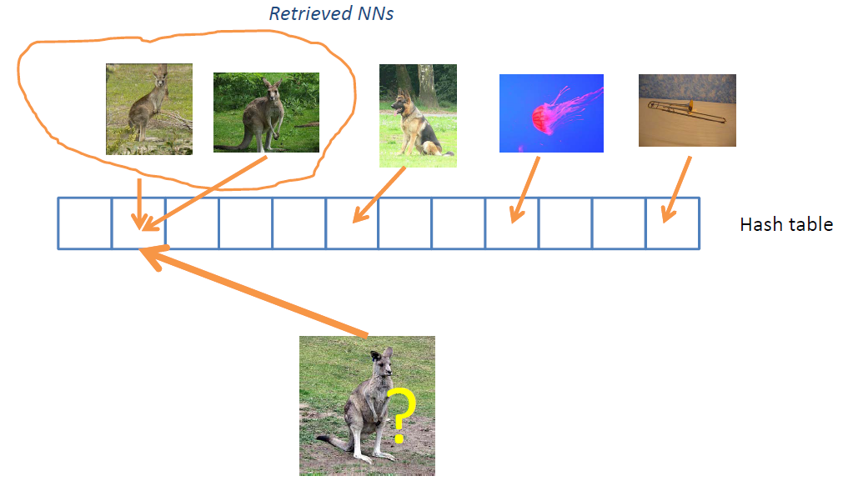
Example: Random projection

Slide 31
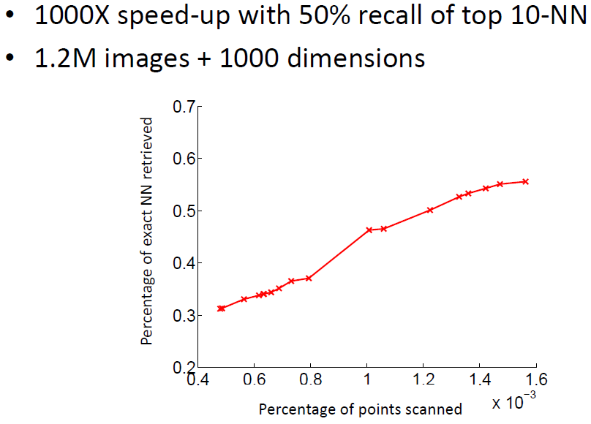
Locally Sensitive Hashing

Slide 32
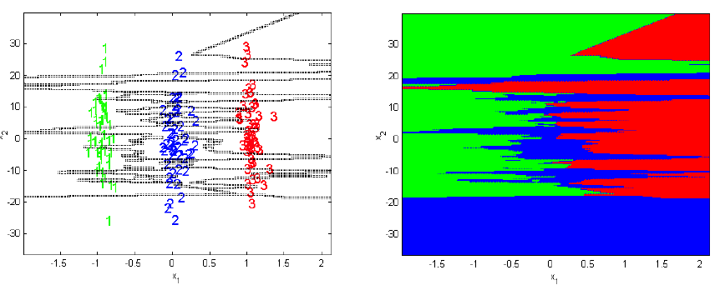
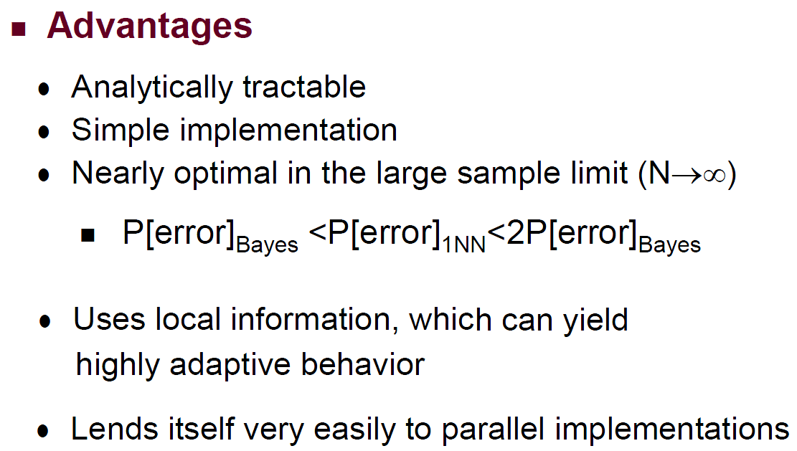
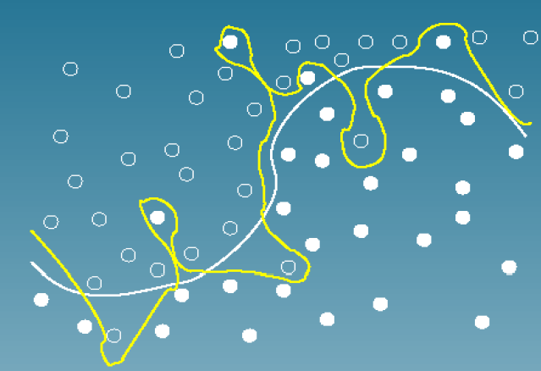
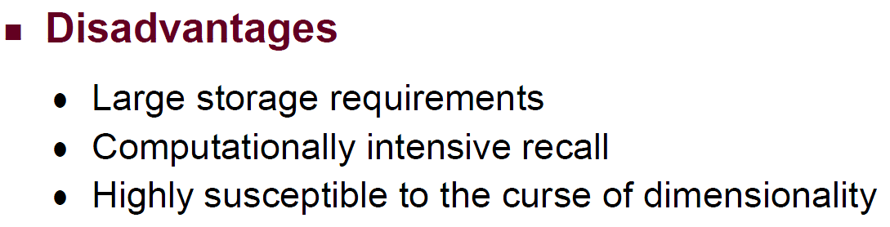
kNN classification

Slide 33
Outline
Introduction
kNN
SVM
Cross validation
Summary

Slide 34
SVM (Support Vector Machines)
Motivation
Linear classifiers
What is margin
Why maximum margin
Hard Margins
Linear SVM
Kernel SVM
Soft Margins

Slide 35
Linear Classifiers
A simplest classification model
Help to understand nonlinear models
Arguably the most useful classification method!

Slide 36
Linear Classifiers
α
x
f
y^{est}
f(x,w,b) = sign(w. x +b)
denotes +1
denotes -1
How would you classify this data?

Slide 37
Linear Classifiers
α
x
f
y^{est}
f(x,w,b) = sign(w. x +b)
denotes +1
denotes -1
How would you classify this data?

Slide 38
Linear Classifiers
α
x
f
y^{est}
f(x,w,b) = sign(w. x +b)
denotes +1
denotes -1
How would you classify this data?

Slide 39
Linear Classifiers
α
x
f
y^{est}
f(x,w,b) = sign(w. x +b)
denotes +1
denotes -1
How would you classify this data?

Slide 40
Linear Classifiers
α
x
f
y^{est}
f(x,w,b) = sign(w. x +b)
denotes +1
denotes -1
Any of these would be fine..
..but which is best?

Slide 41
Classifier Margin
α
x
f
y^{est}
f(x,w,b) = sign(w. x +b)
denotes +1
denotes -1
Define the margin of a linear classifier as the width that the boundary could be increased by before hitting a datapoint.

Slide 42
Maximum Margin and why
denotes +1
denotes -1
The maximum margin linear classifier is the linear classifier with maximum margin.
Intuitively this feels safest.
If we’ve made a small error in the location of the boundary this gives us least chance of causing a misclassification.
It also helps generalization
There’s some theory that this is a good thing.
Empirically it works very very well.

Slide 43
Computing the margin width
“Predict Class = +1” zone
M = Margin Width
“Predict Class = -1” zone
wx+b=1
wx+b=0
wx+b=-1
How do we compute M in terms of w and b?
Plus-plane = { x : w . x + b = +1 }
Minus-plane = { x : w . x + b = -1 }
Margin M=
c
-c

Slide 44
Another way to understand max margin
For f(x)=w.x+b, one way to characterize the smoothness of f(x) is
Therefore, margin measures the smoothness of f(x).
As a rule of thumb, machine learning prefers smooth functions: similar x’s should have similar y’s.

Slide 45
Maximum Margin
α
x
f
y^{est}
f(x,w,b) = sign(w. x +b)
denotes +1
denotes -1
The maximum margin linear classifier is the linear classifier with maximum margin.
This is the simplest kind of SVM (support vector machine)
Support Vectors are those datapoints that the margin pushes up against
Linear SVM

Slide 46
SVM (Support Vector Machines)
Motivation
Linear classifiers
What is margin
Why maximum margin
Hard Margins
Linear SVM
Kernel SVM
Soft Margins

Slide 47
Learning the Maximum Margin Classifier
x⁺
M = Margin Width =
“Predict Class = +1” zone
x⁻
“Predict Class = -1” zone
wx+b=1
wx+b=0
wx+b=-1
Given a guess of w and b we can
Compute whether all data points in the correct half-planes
Compute the width of the margin
So now we just need to write a program to search the space of w’s and b’s to find the widest margin that matches all the data points. How?

Slide 48
Learning the Maximum Margin Classifier
What should our quadratic optimization criterion be?
Minimize
What constraints should be?
w . x_{k} + b >= 1 if y_{k} = 1
w . x_{k} + b <= -1 if y_{k} = -1

Slide 49
Solving the Optimization Problem
Need to optimize a quadratic function subject to linear constraints: Quadratic programming (QP)
QP is a well-studied class of optimization algorithms to maximize a quadratic function of some real-valued variables subject to linear constraints.
several (non-trivial) algorithms exist
Find w and b such that
Φ(w) =w^{T}w is minimized
and for all (x_{i}, y_{i}), i=1..n : y_{i} (w^{T}x_{i} + b) ≥ 1

Slide 50
Quadratic Programming
Find
Quadratic criterion
Subject to
n additional linear inequality constraints
And subject to
e additional linear equality constraints

Slide 51
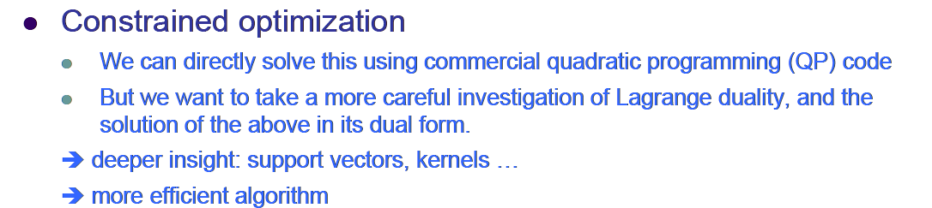
The Lagrangian Dual Problem
Find w and b such that
Φ(w) =w^{T}w is minimized
and for all (x_{i}, y_{i}), i=1..n : y_{i} (w^{T}x_{i} + b) ≥ 1

Slide 52
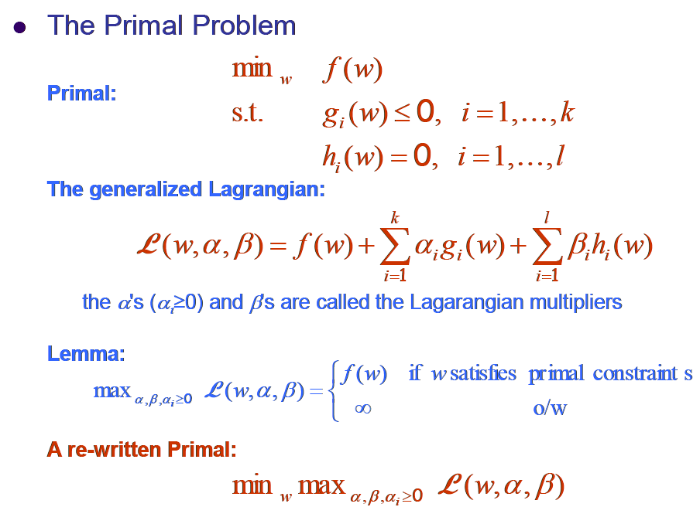
The Lagrangian Dual Problem

Slide 53
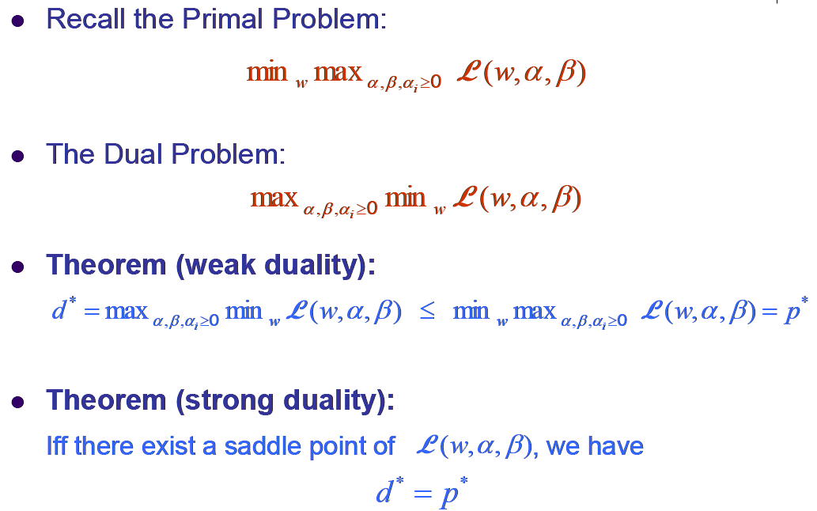
The Lagrangian Dual Problem

Slide 54

The KKT conditions
Primal problem
Dual problem

Slide 55

The Lagrangian Dual Problem

Slide 56


The Lagrangian Dual Problem

Slide 57

The Lagrangian Dual Problem
positive definite

Slide 58

SVM

Slide 59


SVM

Slide 60


SVM

Slide 61
SVM (Support Vector Machines)
Motivation
Linear classifiers
What is margin
Why maximum margin
Hard Margins
Linear SVM
Kernel SVM
Soft Margins

Slide 62


Non-linear Classifier

Slide 63

The Kernel Trick

Slide 64

The Kernel Trick

Slide 65

An Example for feature mapping and kernels

Slide 66

The Kernel Trick

Slide 67

More examples of kernel functions

Slide 68
SVM (Support Vector Machines)
Motivation
Linear classifiers
What is margin
Why maximum margin
Hard Margins
Linear SVM
Kernel SVM
Soft Margins

Slide 69
Soft Margin Classification
What if the training set is not exactly separable?
Slack variables ε_{i} can be added to allow misclassification of difficult or noisy examples, resulting so-called soft margin.
ε_{i}
ε_{i}

Slide 70
Learning Maximum Margin with Noise
M =
Given guess of w , b we can
Compute sum of distances of points to their correct zones
Compute the margin width
Assume R data points, each (x_{k},y_{k}) where y_{k} = +/- 1
ε₁₁
ε₂
wx+b=1
ε₇
wx+b=0
wx+b=-1
What should our quadratic optimization criterion be?
Minimize
How many constraints will we have? R
What should they be?
w . x_{k} + b >= 1-ε_{k} if y_{k} = 1
w . x_{k} + b <= -1+ε_{k} if y_{k} = -1
ε_{k} >= 0 for all k
ε_{k} = distance of error points to their correct place

Slide 71
Soft Margin Classification Mathematically
The old formulation:
Modified formulation incorporates slack variables:
Parameter C can be viewed as a way to control overfitting: it “trades off” the relative importance of maximizing the margin and fitting the training data.
Find w and b such that
Φ(w) =w^{T}w is minimized
and for all (x_{i} ,y_{i}), i=1..n : y_{i} (w^{T}x_{i} + b) ≥ 1
Find w and b such that
Φ(w) =w^{T}w + CΣξ_{i} is minimized
and for all (x_{i} ,y_{i}), i=1..n : y_{i} (w^{T}x_{i} + b) ≥ 1 – ξ_{i,} , ξ_{i} ≥ 0

Slide 72

The Optimization Problem of Soft Margin Classification

Slide 73

Soft Margin Classification

Slide 74

Examples

Slide 75

Examples

Slide 76
Outline
Introduction
kNN
SVM
Cross validation
Summary

Slide 77
Cross validation
see PRML03_Cross-validation.pdf

Slide 78
Outline
Introduction
kNN
SVM
Cross validation
Summary

Slide 79
Hinge loss
Find w and b such that
Φ(w) =w^{T}w + CΣξ_{i} is minimized
and for all (x_{i} ,y_{i}), i=1..n : y_{i} (w^{T}x_{i} + b) ≥ 1 – ξ_{i,} , ξ_{i} ≥ 0
The soft margin SVM is equivalent to applying a hinge Loss
Equivalent unconstrained optimization formulation
min_{{w,b}} L(w,b)+λ||w||² λ=0.5/C
L
2
− Hinge Loss
− 0-1 Loss
1
y.(w.x+b)
0
1
2

Slide 80
General formulation of classifiers
min_{{w,b}} L(w,b)+λ||w||²
The objective: empirical loss + regularization
The regularization term is usually L2 norm, but also often L1 norm for sparse models
The empirical loss can be hinge loss, logistic loss, smooth hinge loss, … or your own invention

Slide 81
Classifiers in practice and research
Linear classifiers are simple and scalable
Training complexity is linear or sub-linear w.r.t. data size
Classification is simple to implement
State-of-the-art for texts, images, …
Their success depends on quality of features
A useful practice: use a lot of features, learn sparse w
Hot topic: large-scale classification
Many data, many features, many classes
Stochastic optimization
Parallel implementation

